Slide 1
Angular (v14* - TIAA) & Micro Front End Application Session2 24/Aug/2023
Paul

Slide 2
Session Objective
Typescript and why ?
Importance of Angular CLI
Importance of Component and Modules
Decorator in Angular
Annotationa or MetaData

Slide 3
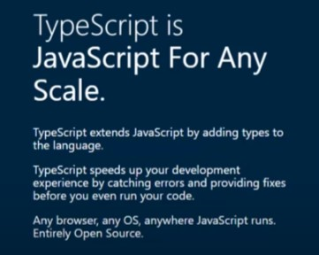
Type Script & Why?
https://www.typescriptlang.org/

Slide 4
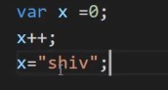
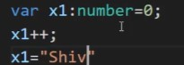
JS
TS

Slide 5
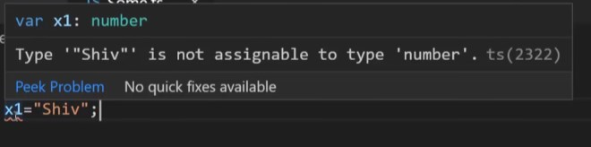
JS
TS

Slide 6
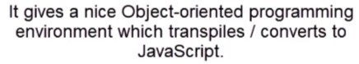
JS
TS
npm install -g typescript

Slide 7
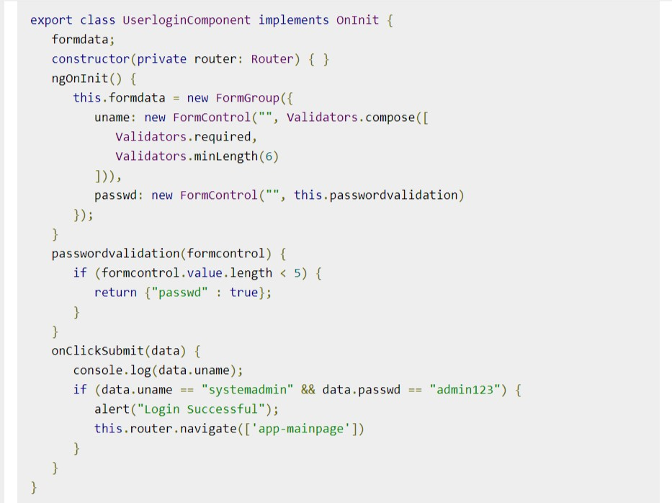
TS
TS

Slide 8
Convert ts to js
TS
>npm install -g typescript
>tsc what.ts

Slide 9
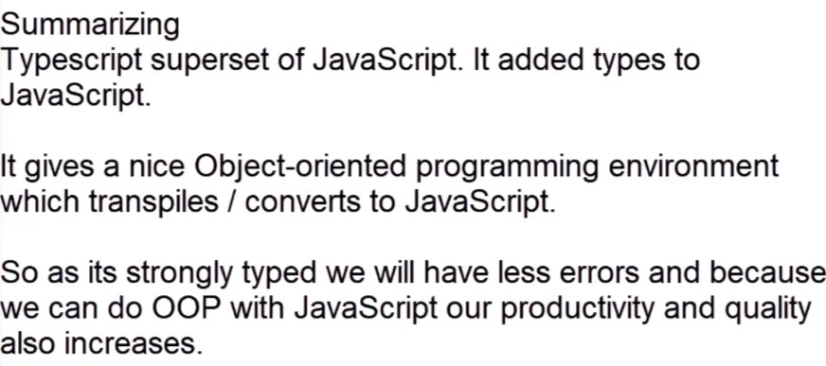

Slide 10
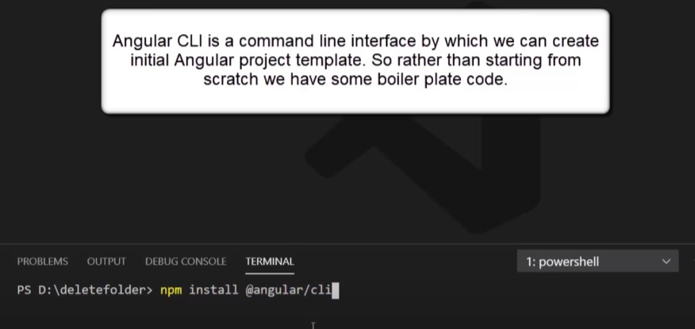
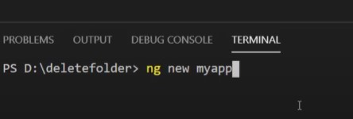
What is the use of Angular CLI ?

Slide 11
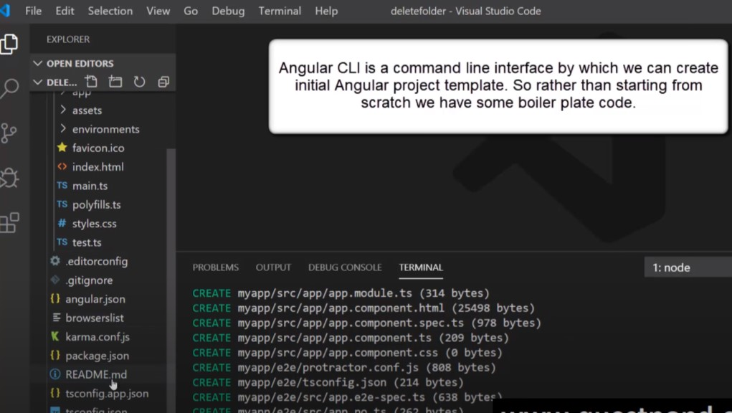
What is the use of Angular CLI ?

Slide 12
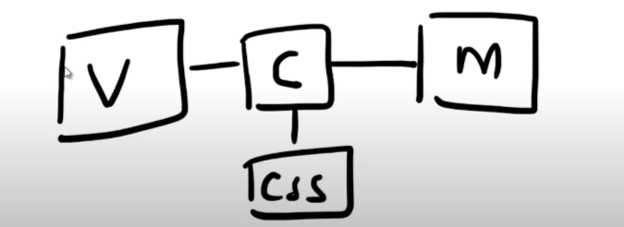
Components and Modules
Difference

Slide 13
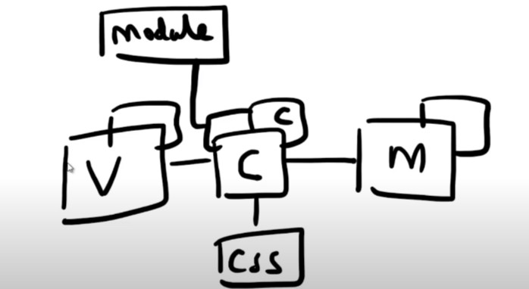
Components and Modules
Difference

Slide 14
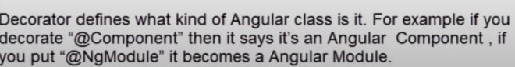
What are decorators in Angular ?
Types of Decorator
Class
Property
Method
Parameter

Slide 15
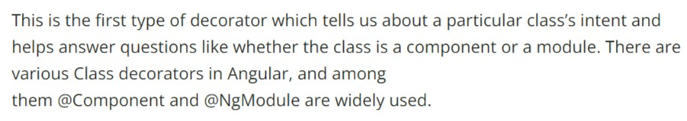
What are decorators in Angular ?
Types of Decorator : Class

Slide 16
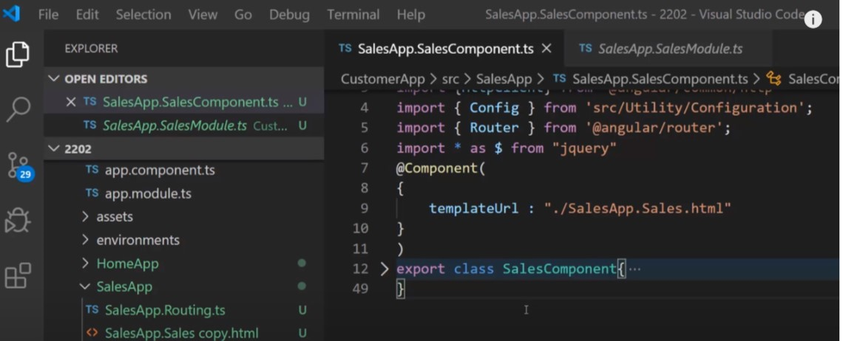
Types of Decorator : Class
@component – decorator

Slide 17
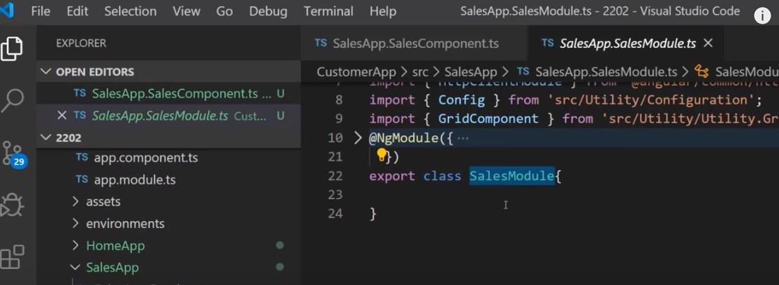
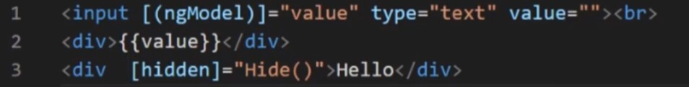
Types of Decorator : Class
@NgModule – decorator

Slide 18
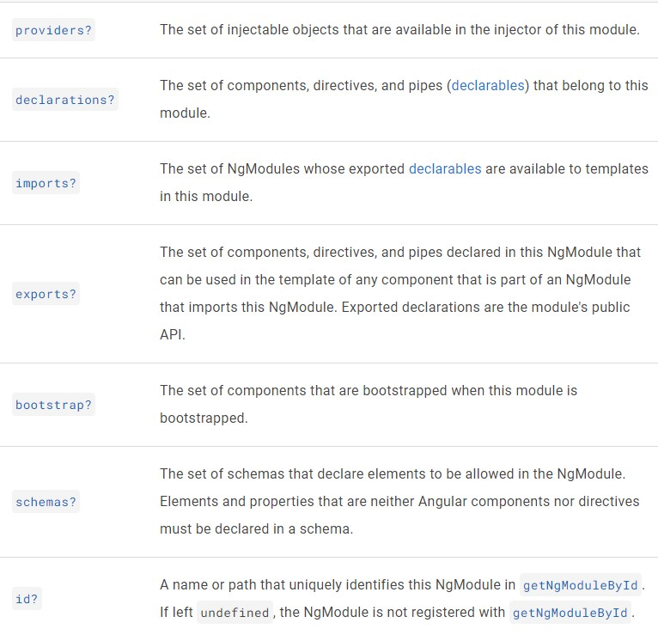
Types of Decorator : Class

Slide 19
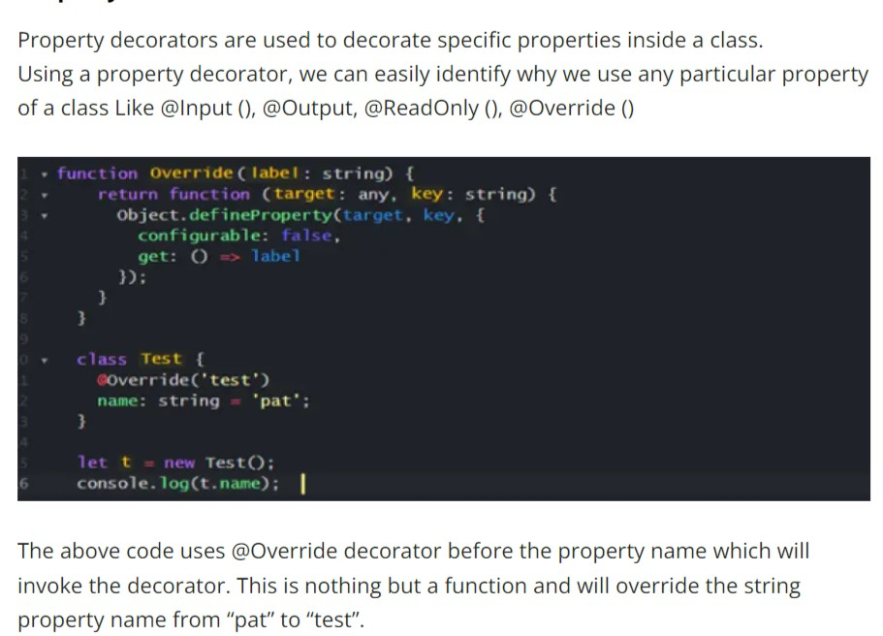
Types of Decorator : Property

Slide 20
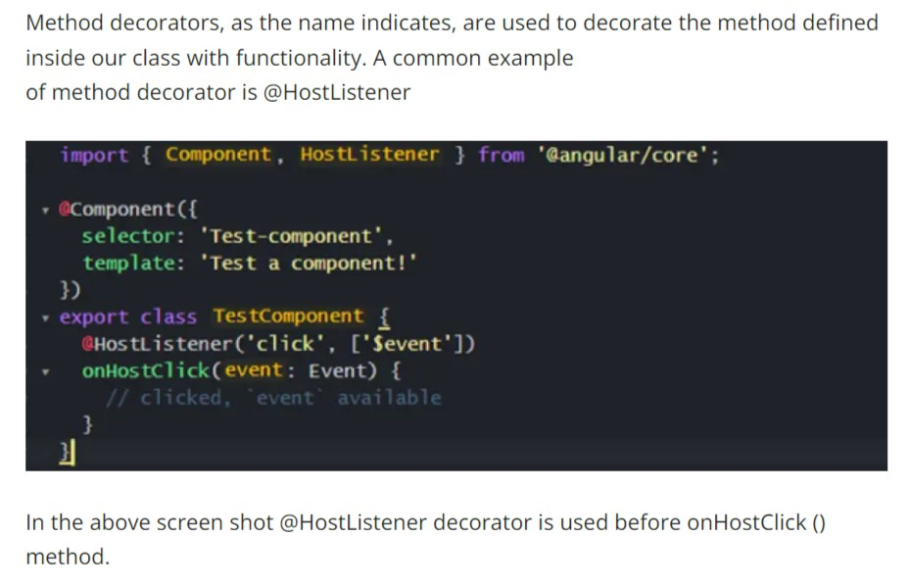
Types of Decorator : Method

Slide 21
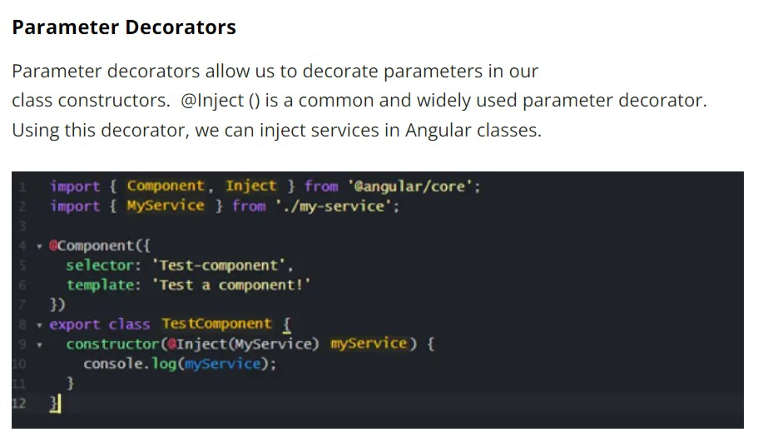
Types of Decorator : Parameters

Slide 22
Annotation or Meta data vs Decorators in angular
Difference

Slide 23
Knowledge Check

Slide 24
1) javascript is super set of typescript? true or false >2) tsc js <filename>.js - is the command is to convert ts into js? true or false 3) directives and decorators are not same ? true or false

Slide 25
Q & A

Slide 26
Thank you
Thank you!

